Slide 1
CHAPTER 1: Distributed System Models and Enabling Technologies
Software Environments for Distributed Systems and Clouds
1.4.1 Service-Oriented Architecture (SOA)
1.4.2 Trends toward Distributed Operating Systems
1.4.3 Parallel and Distributed Programming Models

Slide 2
SOFTWARE ENVIRONMENTS FOR DISTRIBUTED SYSTEMS AND CLOUDS
Service-Oriented Architecture (SOA)
In grids/web services – an entity is - a service
In Java – an entity is - a java object, and
In CORBA - an entity is - a CORBA distributed object.
These architectures are build on
- traditional seven OSI layers
- that provide base networking abstractions.
On top of this we have a base software environment, which would be:
- .NET or Apache Axis for web services,
- Java Virtual Machine for Java, and
- a broker network for CORBA.
On top of this base environment - a higher level environment
- reflecting the special features of the distributed computing environment.
Figure 1.20 shows the layered architecture for distributed entities used in web services and grid systems.

Slide 3
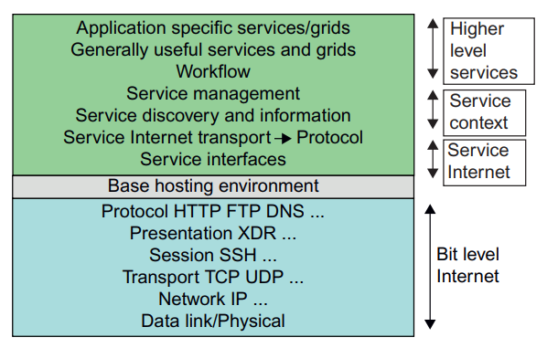


Slide 4
Layered Architecture for Web Services and Grids
The entity interfaces correspond to:
- Web Services Description Language (WSDL),
- Java method, and
- CORBA interface definition language (IDL) specifications
in these example distributed systems.
(CORBA - Common Object Request Broker Architecture)
These interfaces are linked with customized, high-level communication systems: SOAP, RMI, and IIOP in the three examples.
WSDL – SOAP
Java Method – RMI
CORBA – IIOP
IIOP (Internet Inter-ORB Protocol) - used for distributed programs written in different programming languages to communicate over the Internet.

Slide 5
These communication systems supports the following features:
- message patterns (such as Remote Procedure Call or RPC),
- fault recovery, and
- specialized routing.
Often, these communication systems are built on:
- message-oriented middleware (enterprise bus) infrastructure
- such as WebSphere MQ or Java Message Service (JMS)
- which support virtualization of routing, senders, and recipients.
In the case of fault tolerance:
- features in the Web Services Reliable Messaging (WSRM) framework
- mimic the OSI layer capability modified to match the different abstractions (such as messages versus packets, virtualized addressing).
Security is a critical capability that either uses or reimplements the capabilities seen in concepts such as Internet Protocol Security (IPsec) and secure sockets in the OSI layers.

Slide 6
Web Services and Tools
Figure 1.20 corresponds to two choices of service architecture: web services or REST systems
Both web services and REST systems have very distinct approaches to building reliable interoperable systems.
In web services, one aims to fully specify all aspects of the service and its environment. This specification is carried with communicated messages using Simple Object Access Protocol (SOAP).
In a web services language, REST has minimal information in the header, and the message body carries all the needed information.
REST architectures are clearly more appropriate for rapid technology environments.
Note: REST can use XML schemas but not those that are part of SOAP; “XML over HTTP” is a popular design choice in this regard.

Slide 7
The Evolution of SOA
As shown in Figure 1.21, service-oriented architecture (SOA) has evolved over the years.
SOA applies to building grids, clouds, grids of clouds, clouds of grids, clouds of clouds (also known as interclouds), and systems of systems in general.
A large number of sensors provide data-collection services, denoted in the figure as SS (sensor service).
A sensor can be a ZigBee device, a Bluetooth device, a WiFi access point, a personal computer, a GPA, or a wireless phone, among other things.
Raw data is collected by sensor services.
All the SS devices interact with large or small computers, many forms of grids, databases, the compute cloud, the storage cloud, the filter cloud, the discovery cloud, and so on.

Slide 8
Filter services (fs in the figure) are used to eliminate unwanted raw data, in order to respond to specific requests from web, grid, or web services.
Processing this data will generate useful information, and subsequently, the knowledge for our daily use.
In fact, wisdom or intelligence is sorted out of large knowledge bases.
Finally, we make intelligent decisions based on both biological and machine wisdom.
Most distributed systems require a web interface or portal.
For raw data collected by a large number of sensors to be transformed into useful information or knowledge, the data stream may go through a sequence of compute, storage, filter, and discovery clouds.
Finally, the inter-service messages converge at the portal, which is accessed by all users.

Slide 9
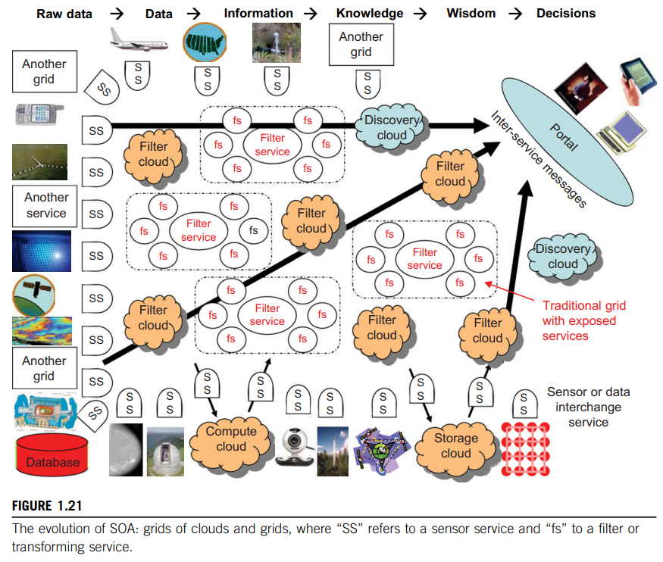

Slide 10
Grids versus Cloud
The boundary between grids and clouds are getting blurred in recent years.
In general, a grid system applies static resources, while a cloud emphasizes elastic resources.
For some researchers, the differences between grids and clouds are limited only in dynamic resource allocation based on virtualization and autonomic computing.
Thus one may end up building with a system of systems: such as a cloud of clouds, a grid of clouds, or a cloud of grids, or inter-clouds as a basic SOA architecture.

Slide 11
Trends toward Distributed Operating Systems
The computers in most distributed systems are loosely coupled.
Thus, a distributed system inherently has multiple system images.
This is mainly due to the fact that all node machines run with an independent operating system.
To promote resource sharing and fast communication among node machines, it is best to have a distributed OS that manages all resources coherently and efficiently.
Such a system is most likely to be a closed system, and it will likely rely on message passing and RPCs for inter node communications.
Thus, a distributed OS is crucial for upgrading the performance, efficiency, and flexibility of distributed applications.

Slide 12
Distributed Operating Systems
Tanenbaum [26] identifies three approaches for distributing resource management functions in a distributed computer system.
First approach - to build a network OS over a large number of heterogeneous OS platforms.
Such an OS offers the lowest transparency to users, and is a distributed file system.
Second approach - to develop middleware to offer a limited degree of resource sharing, similar to the MOSIX/OS developed for clustered systems.
Third approach - to develop a truly distributed OS to achieve higher use or system transparency.
Table 1.6 compares the functionalities of these three distributed operating systems.

Slide 13
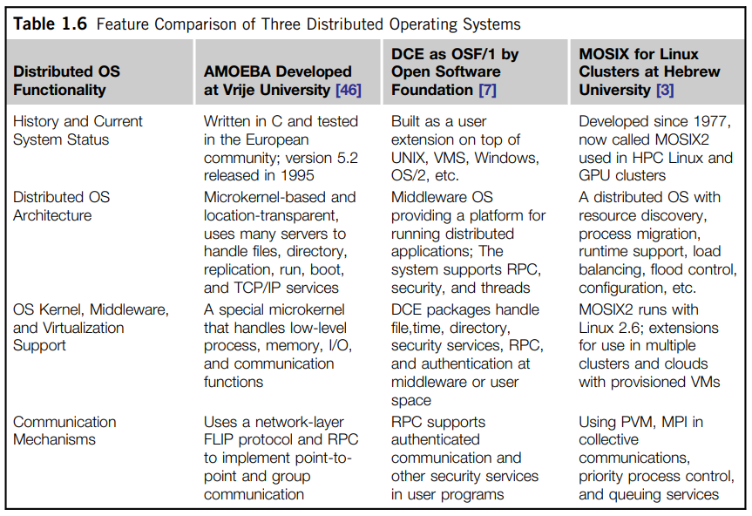

Slide 14
Amoeba versus DCE
Amoeba – a distributed Operating System - developed at Netherlands.
DCE is a middleware-based system for distributed computing environments.
Open Software Foundation (OSF) - pushed the use of DCE for distributed computing.
However, the Amoeba, DCE, and MOSIX2 are still research prototypes that are primarily used in academia.
We need new web-based operating systems to support virtualization of resources in distributed environments. This is still a wide-open area of research.
Conventional OS runs only on a centralized platform.
With the distribution of OS services, the distributed OS design should take a lightweight microkernel approach like Amoeba, or should extend an existing OS like the DCE, by extending UNIX.

Slide 15
MOSIX2 for Linux Clusters
MOSIX2 is a distributed OS, which runs with a virtualization layer in the Linux environment.
This layer provides a partial single-system image to user applications.
Supports both sequential and parallel applications.
MOSIX2 can manage a Linux cluster or a grid of multiple clusters.
A MOSIX-enabled grid can extend indefinitely as long as trust exists among the cluster owners.
The MOSIX2 is being explored for managing resources in all sorts of clusters, including Linux clusters, GPU clusters, grids, and even clouds if VMs are used.

Slide 16
Transparency in Programming Environments
Figure 1.22 shows the concept of a transparent computing infrastructure for future computing platforms.
User data, applications, OS & hardware - separated into four levels.
Data is owned by users, independent of the applications.
OS provides clear interfaces, standard programming interfaces, or system calls to application programmers.
Thus, users will be able to choose from different OSes on top of the hardware devices they prefer to use.
To separate user data from specific application programs, users can enable cloud applications as SaaS.
Thus, users can switch among different services.
The data will not be bound to specific applications.

Slide 17
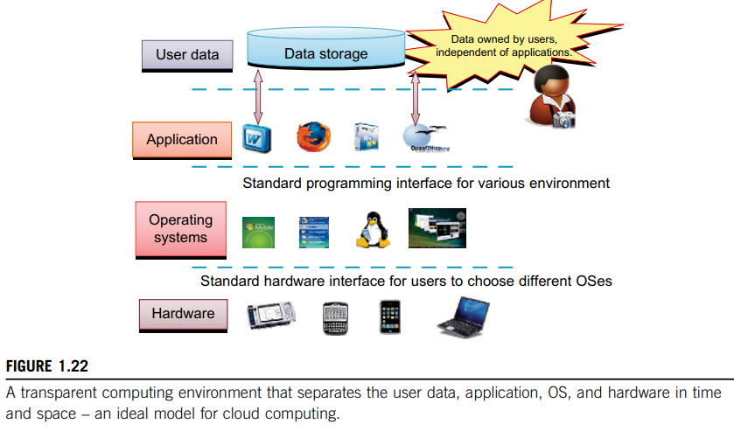

Slide 18
Parallel and Distributed Programming Models
Here, we explore four programming models for distributed computing with expected scalable performance and application flexibility.
Table 1.7 summarizes three of these models, along with some software tool sets developed in recent years.
MPI - most popular programming model for message-passing systems.
Google’s MapReduce and BigTable - for effective use of resources from Internet clouds and data centers.
Service clouds demand extending Hadoop, EC2, and S3 to facilitate distributed computing over distributed storage systems.

Slide 19
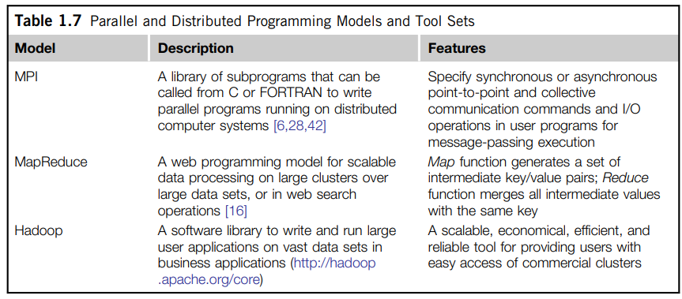

Slide 20
Message-Passing Interface (MPI
A primary programming standard used to develop parallel and concurrent programs to run on a distributed system.
MPI - is a library of subprograms that can be called from C or FORTRAN to write parallel programs running on a distributed system.
The idea is to embody clusters, grid systems, and P2P systems with upgraded web services and utility computing applications.
Besides MPI, distributed programming can be also supported with low-level primitives such as the Parallel Virtual Machine (PVM).

Slide 21
MapReduce
Is a web programming model for scalable data processing on large clusters over large data sets.
Applied mainly in web-scale search & cloud computing applications.
The user specifies a Map function to generate a set of intermediate key/value pairs.
Then the user applies a Reduce function to merge all intermediate values with the same intermediate key.
MapReduce is highly scalable to explore high degrees of parallelism at different job levels.
Hundreds of MapReduce programs can be executed simultaneously; in fact, thousands of MapReduce jobs are executed on Google’s clusters every day.

Slide 22
Hadoop Library
Hadoop offers software platform (developed by a Yahoo! Group).
The package enables users to write and run applications over vast amounts of distributed data.
Users can easily scale Hadoop to store and process petabytes of data in the web space.
Also, Hadoop is economical in that it comes with an open source version of MapReduce.

Slide 23
Open Grid Services Architecture (OGSA)
Development of grid infrastructure is driven by large-scale distributed computing applications.
These applications must count on a high degree of resource and data sharing.
Table 1.8 introduces OGSA as a common standard for general public use of grid services.
Key features:
- A distributed execution environment,
- Public Key Infrastructure (PKI) services (using a local certificate authority (CA))
- trust management, and
- security policies in grid computing.

Slide 24
